Slide 1
Lecture #14 -That’s all folks!
Binary Tree Review
Binary Search Tree Node Deletion
Uses for Binary Search Trees
Huffman Encoding
Balanced Trees
Final Exam: Thursday, Aug 11th
9:00am-12:00pm
Final Exam Location: Haines 39

Slide 2
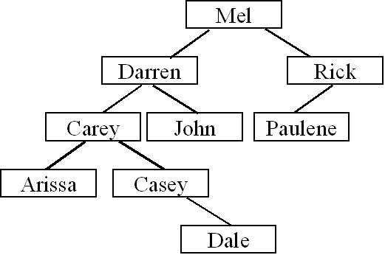
Binary Tree Review
void PostOrder(Node *cur)
{
if (cur == NULL) return;
PostOrder(cur->left); // Process nodes in left sub-tree.
PostOrder(cur-> right); // Process nodes in right sub-tree.
cout << cur->value; // Process the current node.
}
Question #1: What’s the post-order traversal for the following tree?
Question #2: Is the above tree a valid binary search tree?
Question #3: How about now?
Max

Slide 3

Binary Search Tree Insertion Review
Question #1: Show where you would insert “Cathy”
Question #2: How would you go about inserting “Dan”.
Cathy

Slide 4
Deleting a Node from a Binary Search Tree
By simply moving an arbitrary node into Darren’s slot, we violate our Binary Search Tree ordering requirement!
Carey is NOT less than Arissa!
Next we’ll see how to do this properly….
Now, let’s learn how to delete an item from a BST.
It’s not as easy as you might think!
Let’s say we want to delete Darren from our tree…
NO!
Now how do I re-link the nodes back together?
X
Can I just move Arissa into Darren’s old slot?
Hmm.. It seems OK, but is our tree still a valid binary search tree?
Arissa

Slide 5
Deleting a Node from a Binary Search Tree
Here’s a high-level algorithm to delete a node from a Binary Search Tree:
Given a value V to delete from the tree:
Find the value V in the tree, with a standard BST search.
Use two pointers: a cur pointer & a parent pointer
If the node was found, delete it from the tree, making sure to preserve its ordering!
There are three cases, so be careful!

Slide 6
BST Deletion: Step #1
Step 1: Searching for value V
Let’s delete Casey
parent = NULL
cur = root
While cur != NULL
If V == cur->value, then we’re done.
If (V < cur->value)
parent = cur;
cur = cur->left;
C. Else if (V > cur->value)
parent = cur;
cur = cur->right;
Casey < Mel?
Casey < Darren?
Casey < Carey?
parent
cur
parent
parent
cur
parent
cur
cur
And we’ve found our node!
parent
NULL

Slide 7
BST Deletion: Step #2
Once we’ve found our node, we have to delete it. There are 3 cases.
Case 1:
Our node is a leaf.
Case 2:
Our node has one child
Case 3:
Our node has two children.
parent
cur
parent
cur
parent
cur

Slide 8
BST Deletion: Step #2
Hmm. Our target node “cur” isn’t the parent’s left child…
Case 1 and 2 are trivial (if you already know linked lists):
if (parent->left == cur)
parent->left = NULL;
else // if (parent->right == cur)
parent->right = NULL;
Case 1:
Our node is a leaf.
ptr
delete cur;
parent
cur
X

Slide 9
BST Deletion: Step #2
Case 1 continued… A special case!
If the node to delete is:
a. the root node, and
b. it’s a leaf
then just
a. delete cur node, and
b. set the root pointer to NULL
Case 1 (special):
We’re deleting the root of a tree that has 1 child.
ptr
NULL
parent = NULL
X
cur
Mel

Slide 10
BST Deletion: Step #2
Since this is case #2, cur is guaranteed to have only one child…
Is it a left child or a right child?
Let’s look at case #2 now… There are 3 sub-steps!
Ahhh. In this case cur has a left child.
Case 2:
Our node has one child
// get a pointer to cur’s only child
Node *grandchild;
if (cur->left != NULL)
grandchild = cur->left;
else
grandchild = cur->right;
Now we have to link our parent to its grandchild (since cur is dying).
Should we link parent->left to the grandchild?
Or should we link parent->right to the grandchild?
parent
In this case, the right side of parent’s family tree has the grandchild.
Thus we want to relink parent->right from cur to the grandchild.
cur
X
// Link parent to grandchild
if (parent->left == cur)
parent->left = grandchild;
else if (parent->right == cur)
parent->right = grandchild;
grandchild
// free the memory for cur
delete cur;

Slide 11
BST Deletion: Step #2
Here’s how we take care of Case 2 if cur (the node we’re deleting) is the root node.
Case 2:
Our root node has one child
// get a pointer to cur’s only child
Node *grandchild;
if (cur->left != NULL)
grandchild = cur->left;
else
grandchild = cur->right;
parent = NULL
root
X
cur
Mel
Phil
// now link the root pointer
// to the grandchild!
root = grandchild;
Nate
Sam
grandchild
// free the memory for cur
delete cur;

Slide 12
BST Deletion: Step #2
Let’s look at case #3 now. The hard one!
Case 3:
Our node has two children.
We need to select a replacement for Darren that will still leave the BST consistent.
parent
What if we try moving Arissa up?
cur
Arissa
Utoh! If we replace Darren with Arissa, our BST is no longer consistent!
When deleting a node with two children, we have to be very careful!

Slide 13
Let’s Delete k
In general, when deleting a node k….
k
we want to replace k with either:
f
q
K’s left subtree’s largest-valued child
b
h
m
t
Or
2. K’s right subtree’s smallest-valued child
a
d
g
j
p
s
u
c
e
i
n
Only these choices are suitable replacements for our deleted node!

Slide 14
BST Deletion: Step #2
Goal: Replace our target node with a name that is > all names in its left subtree, or < all names in its right subtree.
Case 3:
Our node has two children.
Algorithm:
1. ptr = cur->left
2. while (ptr->right != NULL)
ptr = ptr ->right
3. Copy ptr’s node’s value into temp
4. Remove the node pointed to by ptr from the tree*
5. Copy temp into cur
parent
So now we’ve found the largest value in Cur’s left sub-tree!
cur
ptr
?
ptr
?
X
* ptr has either NO children or a left child. So use BST Deletion Alg #1 or #2.
ptr
Dale
?
temp
Dale
Dale

Slide 15
Deletion Exercise
Explain how you would go about deleting node K.
k
f
n
Explain how you would go about deleting node e.
b
h
l
p
Explain how you would go about deleting node i.
a
d
g
j
m
o
q
c
e
i
igloo
infer

Slide 16
Where are Binary Search Trees Used?
Remember the STL map?
#include <map>
using namespace std;
main()
{
map<string,float> stud2gpa;
stud2gpa[“Carey”] = 3.62;
stud2gpa[“David”] = 3.99;
stud2gpa[“Dalia”] = 4.0;
cout << stud2gpa[“David”];
}
stud2gpa
pRoot
NULL
ID
“Carey”
val
2.1
3.62
// BST insert!
left
NULL
right
NULL
ID
“David”
stud2gpa[“Carey”] = 2.1;
// BST search!
val
3.99
left
NULL
right
NULL
It uses a type of binary search tree to store the items!
ID
“Dalia”
val
4.0
left
right
NULL NULL

Slide 17
Where are Binary Search Trees Used?
The STL set also uses a type of BSTs!
The STL set and map use binary search trees* to enable fast searching.
#include <set>
using namespace std;
main()
{
}
// construct BST
set<int> a;
a.insert(2);
a.insert(3);
a.insert(4);
// insert into BST
Other STL containers of interest: multiset and multimap.
These containers can have duplicate mappings. (Unlike set and map)
a.insert(2);
int n;
n = a.size();
a.erase(2);
// delete from BST

Slide 18


Huffman Encoding: Applying Trees to Real-World Problems
Huffman Encoding is a data compression technique that can be used to compress and decompress files (e.g. like creating ZIP files).

Slide 19
Background
Before we actually cover Huffman Encoding, we need to learn a few things…
Remember the ASCII code?

Slide 20
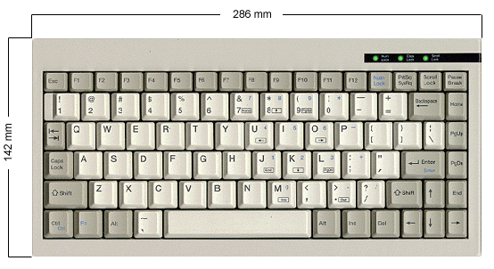

ASCII
Computers represent letters, punctuation and digit symbols using the ASCII code, storing each character as a number.
When you type a character on the keyboard, it’s converted into a number and stored in the computer’s memory!
50
65

Slide 21
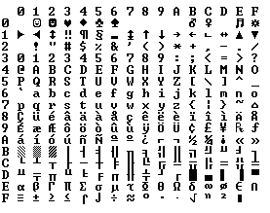
The ASCII Chart
48
0-15
16-31
32-47
48-63
64-79
80-95
96-111
112-127
65
97

Slide 22


Computer Memory and Files
So basically, characters are stored in the computer’s memory as numbers…
data
67
67
main()
{
char data[7] = “Carey”;
ofstream out(“file.dat”);
out << data;
out.close();
}
97
97
114
114
101
101
121
121
0
0
0
0
Similarly, when you write data out to a file, it’s stored as ASCII numbers too!

Slide 23
Bytes and Bits
Now, as you’ve probably heard, the computer actually stores all numbers as 1’s and 0’s (in binary) instead of decimal…
data
01000011
01000011
67
main()
{
char data[7] = “Carey”;
ofstream out(“file.dat”);
out << data;
out.close();
}
01100001
97
01110010
114
01100101
101
01111001
121
00000000
0
00000000
0
Each character is represented by 8 bits.
Each bit can have a value of either 0 or 1
(i.e. 1 = high voltage and 0 = low voltage)

Slide 24
Binary and Decimal
Every decimal number has an equivalent binary representation (they’re just two ways of representing the same thing)
Decimal Number
Binary Equivalent
0
00000000
1
00000001
2
00000010
3
00000011
4
00000100
…
…
255
11111111
So that’s binary…

Slide 25
Consider a Data File
Now lets consider a simple data file containing the data:
“I AM SAM MAM.”
As we’ve learned, this is actually stored as 13 numbers in our data file:
73 32 65 77 32 83 65 77 32 77 65 77 46
And in reality, its really stored in the computer as a set of 104 binary digits (bits):
01001001 00100000 01000001 01001101 00100000 01010011 01000001
01001101 00100000 01001101 01000001 01001101 00101110
(13 characters * 8 bits/character = 104 bits)

Slide 26
Data Compresion
So our original string “I AM SAM MAM.” requires 104 bits to store on our computer… OK.
01001001 00100000 01000001 01001101 00100000 01010011 01000001
01001101 00100000 01001101 01000001 01001101 00101110
The question is:
Can we somehow reduce the number of bits required to store our data?
And of course, the answer is YES!

Slide 27
Huffman Encoding
To compress a file “file.dat” with Huffman encoding, we use the following steps:
Compute the frequency of each character in file.dat.
Build a Huffman tree (a binary tree) based on these frequencies.
Use this binary tree to convert the original file’s contents to a more compressed form.
Save the converted (compressed) data to a file.

Slide 28
Huffman Encoding: Step #1
Step #1: Compute the frequency of each character in file.dat.
(i.e. compute a histogram)
FILE.DAT
S
M
M
I AM SAM MAM.
I
A
M
A
M
A
.
‘A’
‘I’
‘M’
‘S’
Space
Period
3
1
4
1
3
1

Slide 29
Huffman Encoding: Step #2
Step #2: Build a Huffman tree (a binary tree) based on these frequencies:
A. Create a binary tree leaf node for each entry in our table, but don’t insert any of these into a tree!
ch
B. While we have more than one node left:
1. Find the two nodes with lowest freqs.
2. Create a new parent node.
3. Link the parent to each of the children.
4. Set the parent’s total frequency equal to the sum of its children’s frequencies.
5. Place the new parent node in our grouping.
freq
2
1+1
left
right
‘A’
‘I’
‘M’
‘S’
Space
Period
3
1
4
1
3
1
ch
‘.’
ch
‘S’
ch
‘I’
ch
‘A’
ch
‘ ’
ch
‘M’
freq
1
freq
1
freq
1
freq
3
freq
3
freq
4
left
right
left
right
left
right
left
right
left
right
left
right
NULL
NULL
NULL
NULL
NULL
NULL
NULL
NULL
NULL
NULL
NULL
NULL

Slide 30
Huffman Encoding: Step #2
Step #2: Build a Huffman tree (a binary tree) based on these frequencies:
A. Create a binary tree leaf node for each entry in our table, but don’t insert any of these into a tree!
ch
B. While we have more than one node left:
1. Find the two nodes with lowest freqs.
2. Create a new parent node.
3. Link the parent to each of the children.
4. Set the parent’s total frequency equal to the sum of its children’s frequencies.
5. Place the new parent node in our grouping.
freq
2
left
right
ch
freq
3
ch
‘.’
ch
‘S’
left
right
freq
1
freq
1
left
right
left
right
NULL
NULL
NULL
NULL
ch
ch
‘I’
ch
‘A’
ch
‘ ’
ch
‘M’
freq
2
freq
1
freq
3
freq
3
freq
4
left
right
left
right
left
right
left
right
left
right
NULL
NULL
NULL
NULL
NULL
NULL
NULL
NULL
ch
‘.’
ch
‘S’
freq
1
freq
1
left
right
left
right
NULL
NULL
NULL
NULL

Slide 31
Huffman Encoding: Step #2
ch
freq
6
left
right
ch
freq
3
left
right
ch
ch
‘I’
ch
‘A’
ch
‘ ’
ch
‘M’
freq
2
freq
1
freq
3
freq
3
freq
4
left
right
left
right
left
right
left
right
left
right
NULL
NULL
NULL
NULL
NULL
NULL
NULL
NULL
ch
‘.’
ch
‘S’
freq
1
freq
1
left
right
left
right
NULL
NULL
NULL
NULL

Slide 32
Huffman Encoding: Step #2
ch
freq
13
left
right
ch
ch
freq
7
freq
6
left
right
left
right
ch
ch
‘A’
ch
‘ ’
ch
‘M’
freq
3
freq
3
freq
3
freq
4
left
right
left
right
left
right
left
right
NULL
NULL
NULL
NULL
NULL
NULL
ch
ch
‘I’
Ok. Now we have a single binary tree.
freq
2
freq
1
left
right
left
right
NULL
NULL
ch
‘.’
ch
‘S’
freq
1
freq
1
left
right
left
right
NULL
NULL
NULL
NULL

Slide 33
Huffman Encoding: Step #2
Step #2: Build a Huffman tree (a binary tree) based on these frequencies:
A. Create a binary tree leaf node for each entry in our table, but don’t insert any of these into a tree!
ch
B. Build a binary tree from the leaves.
freq
13
left
right
0
C. Now label each left edge with a “0” and
each right edge with a “1”
0
0
0
0
1
1
1
1
1
ch
ch
freq
7
freq
6
left
right
left
right
ch
ch
‘M’
ch
‘A’
ch
‘ ’
freq
3
freq
4
freq
3
freq
3
left
right
left
right
left
right
left
right
NULL
NULL
NULL
NULL
NULL
NULL
ch
ch
‘I’
freq
2
freq
1
left
right
left
right
NULL
NULL
ch
‘.’
ch
‘S’
freq
1
freq
1
left
right
left
right
NULL
NULL
NULL
NULL

Slide 34
Huffman Encoding: Step #2
Now we can determine the new bit-encoding for each character.
ch
freq
13
left
right
0
1
The bit encoding for a character is the path of 0’s and 1’s that you take from the root of the tree to the character of interest.
ch
ch
freq
7
freq
6
left
right
left
right
0
1
0
1
ch
ch
‘M’
ch
‘A’
ch
‘ ’
freq
3
freq
4
freq
3
freq
3
left
right
left
right
left
right
left
right
For example:
1
NULL
NULL
NULL
NULL
NULL
NULL
0
ch
ch
‘I’
S is encoded as 0001
freq
2
freq
1
left
right
left
right
A is encoded as 10
0
1
NULL
NULL
M is encoded as 01
ch
‘.’
ch
‘S’
Notice that characters that occurred more often in our message have shorter bit-encodings!
freq
1
freq
1
Etc…
left
right
left
right
NULL
NULL
NULL
NULL

Slide 35
Huffman Encoding: Step #3
Step #3: Use this binary tree to convert the original file’s contents to a more compressed form..
i.e. find the sequence of bits (1s and 0s) for each char in the message.
ch
freq
13
left
right
0
1
ch
ch
I AM SAM MAM.
freq
7
freq
6
left
right
left
right
0
1
0
1
001
11
10
01
11
0001
10
01
ch
ch
‘M’
ch
‘A’
ch
‘ ’
11
01
10
01
0000
freq
3
freq
4
freq
3
freq
3
left
right
left
right
left
right
left
right
1
NULL
NULL
NULL
NULL
NULL
NULL
0
ch
ch
‘I’
freq
2
freq
1
left
right
left
right
0
1
NULL
NULL
ch
‘.’
ch
‘S’
freq
1
freq
1
left
right
left
right
NULL
NULL
NULL
NULL

Slide 36
Huffman Encoding: Step #4
Step #4: Save the converted (compressed) data to a file.
001
11
10
01
11
0001
10
10
01
001
11
10
01
11
0001
01
11
01
0000
11
01
01
10
01
0000
10
compressed.dat
Notice that our new file less than four bytes or 31 bits long!
Our original file is 13 bytes or 104 bits long!
originalfile.dat
01001001 00100000 01000001 01001101 00100000 01010011 01000001 01001101 00100000
01001101 01000001 01001101
00101110
We saved over 69%!

Slide 37
Ok… So I cheated a bit…
compressed.dat
If all we have is our 31 bits of data… its impossible to interpret the file!
Encoding:
‘A’ = “10”
‘ ‘ = “11”
‘M’ = “01”
‘I’ = “001”
‘.’ = “0000”
‘S’ = “0001”
Encoded Data:
001
11
10
01
11
0001
10
01
11
01
10
01
0000
Did 000 equal “I” or did 000 equal “Q”? Or was it 00 equals “A”?
So, we must add some additional data to the top of our compressed file to specify the encoding we used…
Now clearly this adds some overhead to our file…
But usually there’s a pretty big savings anyway!

Slide 38
Decoding…
Extract the encoding scheme from the compressed file.
Build a Huffman tree (a binary tree) based on the encodings.
Use this binary tree to convert the compressed file’s contents back to the original characters.
Save the converted (uncompressed) data to a file.
ch
compressed.dat
Output:
freq
ch
left
right
Encoding:
‘A’ = “10”
‘ ‘ = “11”
‘M’ = “01”
‘I’ = “001”
‘.’ = “0000”
‘S’ = “0001”
Encoded Data:
freq
I
_
A
M
_SAM_MAM.
0
left
right
1
0
NULL
1
ch
ch
ch
freq
freq
output.dat
left
right
ch
freq
left
right
left
right
freq
left
right
I AM SAM
MAM.
0
1
0
1
NULL
NULL
1
0
1
ch
ch
‘M’
ch
‘A’
ch
‘ ’
freq
ch
freq
freq
freq
‘M’
ch
‘A’
ch
‘ ‘
left
right
freq
left
right
left
right
left
right
NULL
freq
freq
left
right
NULL
NULL
NULL
NULL
NULL
0
1
left
right
left
right
NULL
NULL
NULL
NULL
NULL
NULL
001
11
10
ch
ch
‘I’
(When you hit a leaf node, output ch and then start again at the root!)
freq
(When you hit a leaf node, output ch and then start again at the root!)
01
11
0001
freq
left
right
left
right
10
01
11
01
0
1
NULL
NULL
10
01
0000
ch
‘.’
ch
‘S’
freq
freq
left
right
left
right
NULL
NULL
NULL
NULL

Slide 39
Balanced Search Trees
Question: What happens if we insert the following values into a binary search tree?
5, 10, 7, 9, 8, 20, 18, 17, 16, 15, 14, 13, 12, 11
Question: What is the approximate big-oh cost of searching for a value in this tree?

Slide 40
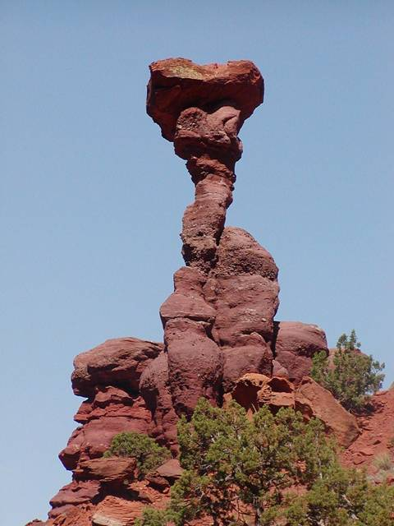
Balanced Search Trees
In real life, trees often end up looking just like our example, especially after repeated insertions and deletions.
It would be nice if we could come up with a tree ADT that always maintained an even height.
This would ensure that all insertions, searches and deletions would be O(log n).

Slide 41
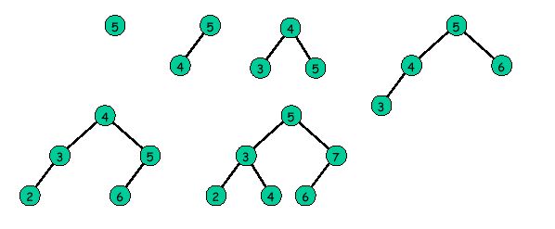
Balanced Search Trees
A binary tree is “perfectly balanced” if for each node, the number of nodes in its left and right subtrees differ by at most one.
Perfectly balanced search trees have a maximum height of log(n), but are difficult to maintain during insertion/deletion.

Slide 42
Balanced Search Trees
There are 3 popular approaches to building a balanced binary search tree :
AVL trees
2-3 trees
Red-black trees
Let’s learn about AVL trees!

Slide 43
AVL Trees
AVL tree: a BST in which the heights of the left and right sub-trees of each node differ at most by 1.
AVL Trees
Non-Legal AVL Trees

Slide 44
Implementing AVL Trees
To implement an AVL tree, each node has a new balance value:
0 if the node’s left and right subtrees have the same height
-1 if the node’s left subtree is 1 higher than the right
1 if the node’s right subtree is 1 higher than the left
value
5
Balance?
Balance?
What’s the balance?
bal
-1
What’s the balance?
-1
0
0
struct AVLNode
{
int value;
int balance;
AVLNode *left, *right;
};
NULL
NULL
value
3
value
19
Balance?
bal
bal
What’s the balance?
1
0
Balance?
0
NULL
NULL
NULL
NULL
value
4
bal
0
Balance?
When we insert a node we have to update all balance values from the new node to the root of the tree…
NULL
NULL

Slide 45
A Non-AVL Tree
0
-2
-2
-1
1
0
0
Notice: Even though the root node has a balance of zero, its sub-trees aren’t balanced!

Slide 46
Insertion into an AVL Tree (the simple case)
Case 1: After you insert the new node, all nodes in the tree still have balances of 0, -1 or 1.
Insert the new node normally (just like in a BST)
Then update the balances of all parent nodes, from the new leaf to the root.
If all of the balances are still 0, -1 or 1, DONE!
Balance values:
-1 = left higher
1 = right higher
0 = even height

Slide 47
Insertion into an AVL Tree (the simple case)
Insert the following values into an AVL tree, showing the balance factor of each node as you go: 4, 7, 2, 8, 6, 1
Val: 4
Bal: 0
Val: 4
Bal: 1
Val: 4
Bal: 0
Val: 4
Bal: 1
Val: 4
Bal: 1
Val: 4
Bal: 0
0
1
1
0
Val: 2
Bal: 0
Val: 2
Bal: 0
Val: 2
Bal: 0
Val: 2
Bal: 0
Val: 7
Bal: 0
Val: 7
Bal: 1
Val: 7
Bal: 0
Val: 7
Bal: 0
Val: 7
Bal: 0
-1
0
1
Val: 1
Bal: 0
Val: 6
Bal: 0
Val: 8
Bal: 0
Val: 6
Bal: 0
Val: 8
Bal: 0
Val: 8
Bal: 0
Balance values:
-1 = left higher
1 = right higher
0 = even height

Slide 48
Insertion into an AVL Tree (more complex case)
Case 2: When you insert a new node, it causes one or more balances to become less than -1 or greater than 1.
We must now “rebalance” the tree so all nodes still have a balance of –1, 0 or 1.
Let’s consider the case of inserting into the right subtree (left is similar)
There are two sub-cases to consider:
Single rotation
Double rotation

Slide 49
Case 2.1: Single Rotation
If we add a node to a subtree that causes any node in the AVL tree to go out of balance, then we rotate:
J
Bal=1
J
Bal=2
Bal=0
J
T
B
T
B
T
B
3
4
4
4
R
5
R
Z
Z
R
Z

Slide 50
Case 2.1: Single Rotation
So, what would our new tree look like if we add a value of 9?
Val: 4
Bal: 0
2
Val: 2
Bal: 0
Val: 7
Bal: 0
1
Val: 7
Bal: 0
0
Val: 6
Bal: 0
Val: 8
Bal: 0
1
Val: 4
Bal: 0
Val: 8
Bal: 0
0
1
Val: 9
Bal: 0
Val: 2
Bal: 0
Val: 6
Bal: 0
Val: 9
Bal: 0
The nodes 2 4 7 8 9, that comprise the ‘outside edge’ of the tree, have been rotated one node to the left.

Slide 51
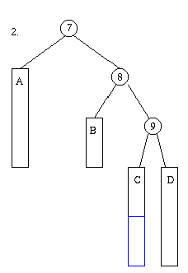
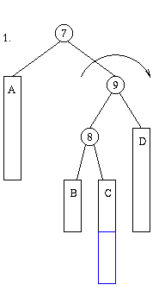
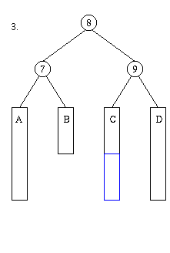
Case 2.1: Double Rotation
In some cases, when we add a node, it requires two rebalances.
But now, node 7 is still unbalanced!

